Slide 1
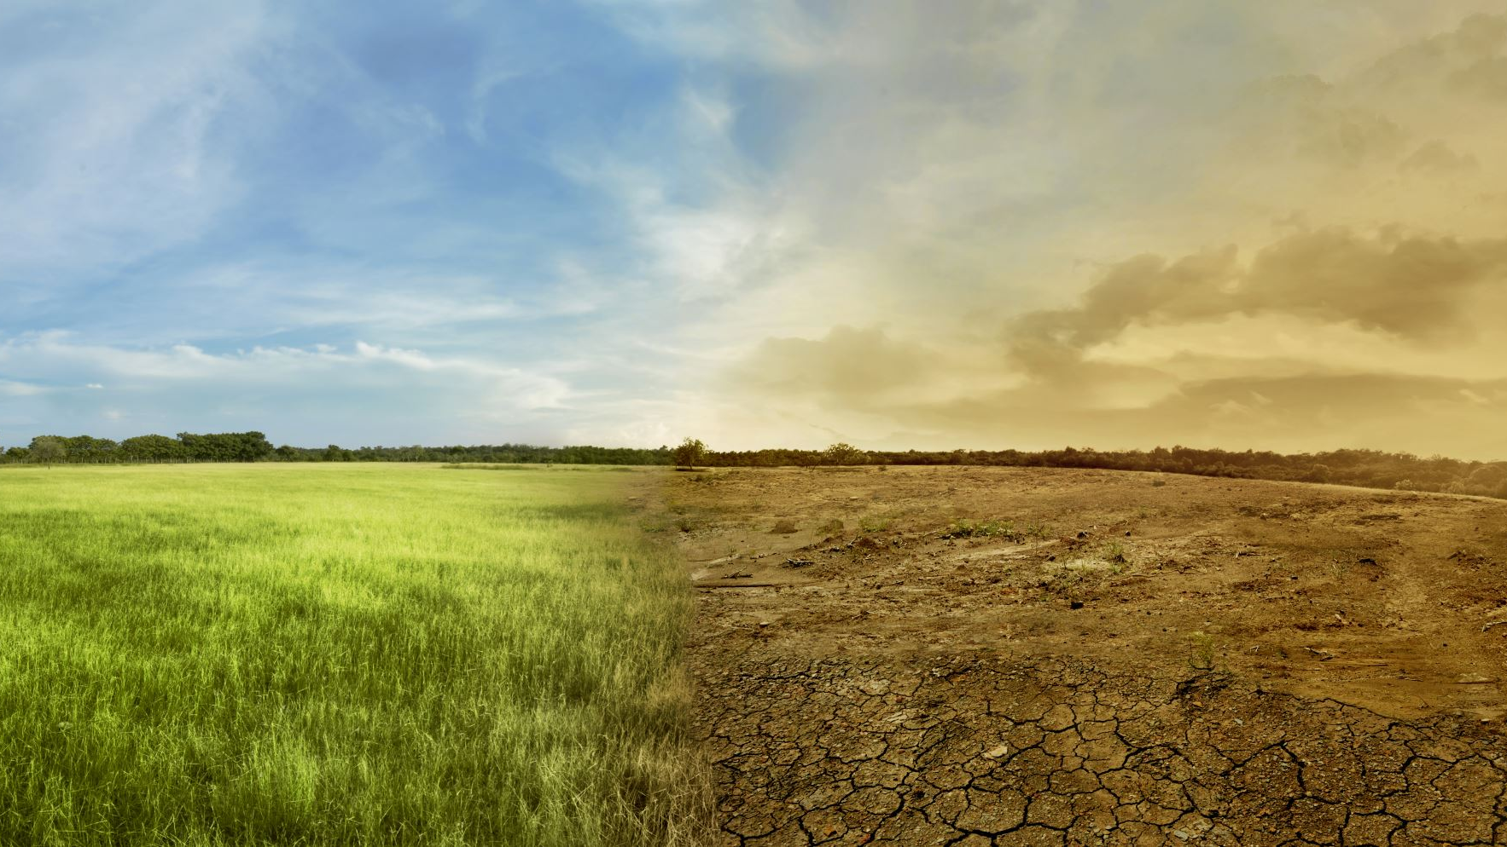
Global Warming
Who’s Responsible for it Anyway?

Slide 2
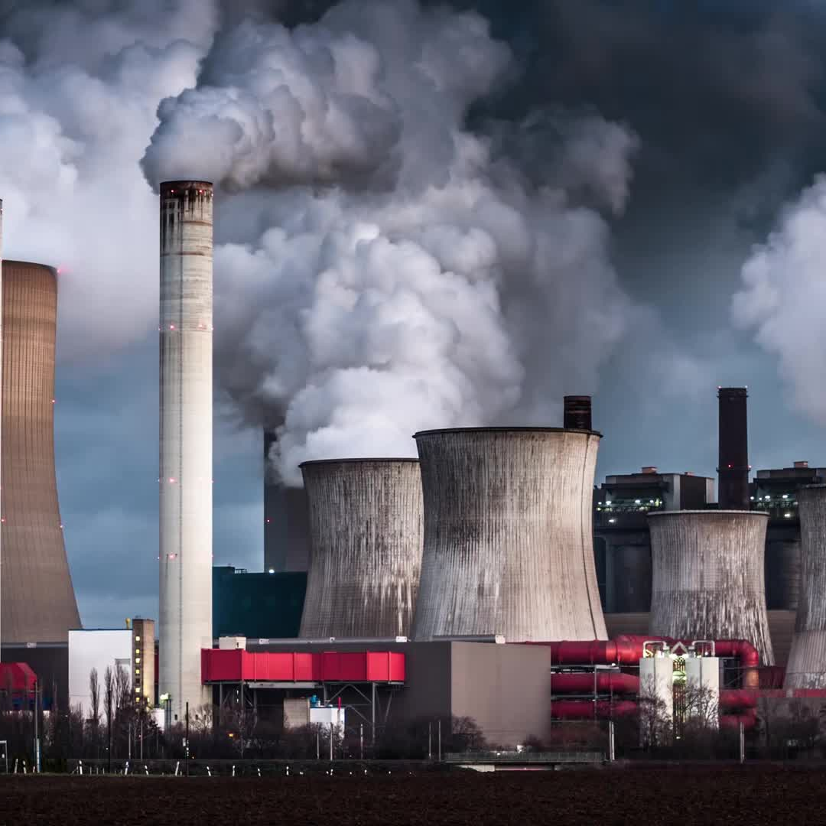
Starting in the mid 1800s the civilized world started what is now known as the Industrial Revolution
Climate was not an issue then, but over time the world’s average temperatures slowly began to rise.
At the present time we see the effects of the higher temperatures in the form of melting ice caps, warmer oceans and seemingly shorter winters.

Slide 3

What’s the Problem?
For this project I have two objectives:
Predict future average temperatures
Determine if the industrialized countries have more bearing on global warming than developing countries

Slide 4

It’s About Time
The data comes from a dataset found on Kaggle
For this project I will use different timeseries dating back to 1870 since this corresponds roughly with the start of the Industrial revolution.

Slide 5

Time to Wrangle the Data!
Aside from having missing temperatures, the dataset is rather clean!
Since temperatures are generally continuous and the reach extremes between seasons, imputing the missing values by interpolation seemed most appropriate approach to filling missing values.
Finally I will create the data frames that will be used for forecasting for each city.

Slide 6
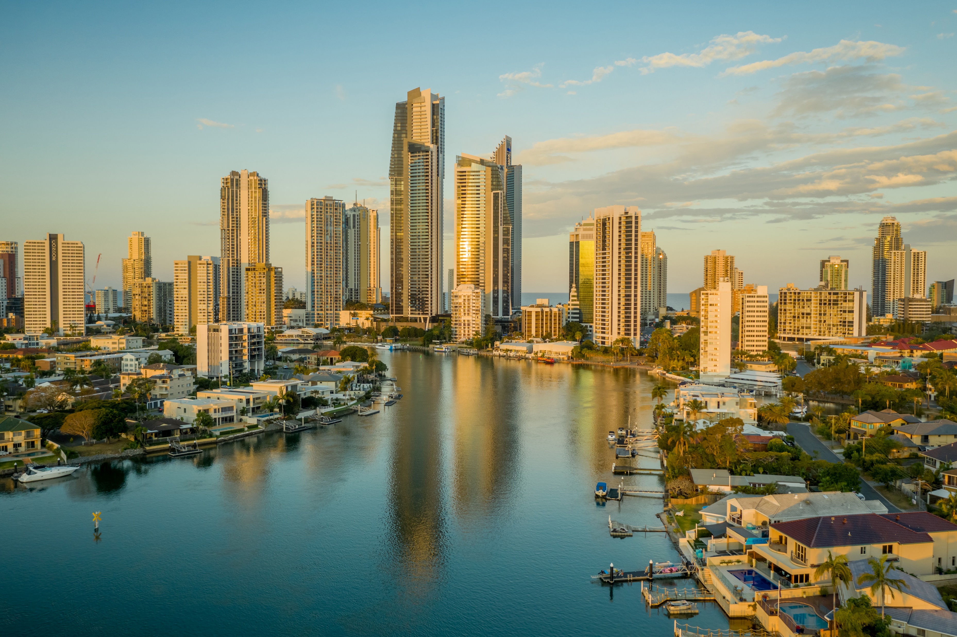

Which Cities to choose?
I chose 3 cities from industrialized nations:
Springfield, United States
Kadoma, Japan
Manchester, United Kingdom
I chose 4 cites from Developing nations:
Jhansi, India
Phnum Penh, Cambodia
Dakar, Senegal
Port Au Prince, Haiti

Slide 7

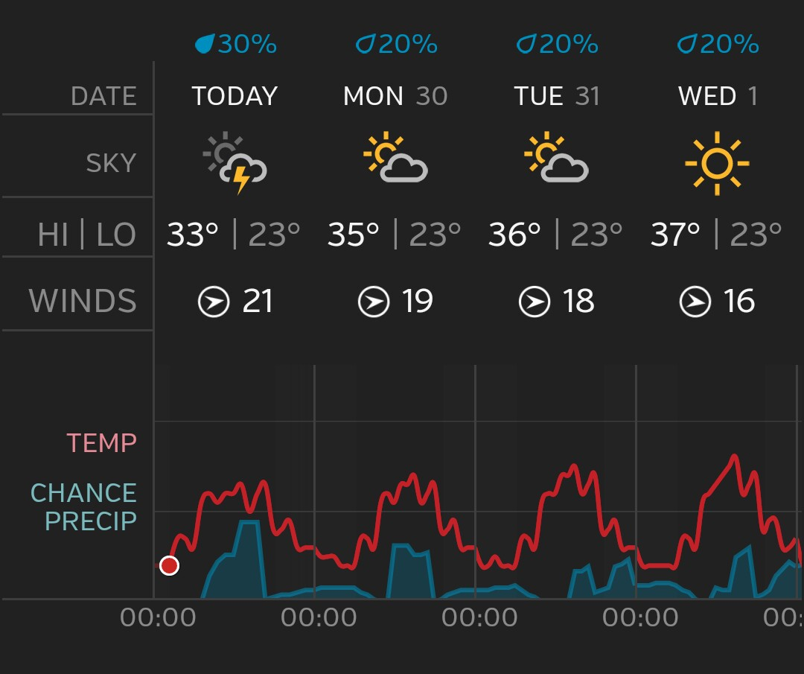
Let’s Forecast!........but First, lets check our forecasting
The model of choice is the ARIMA model
It is versatile
Great for guarding against overfitting
Easy to use for forecasting
This Photo by Unknown Author is licensed under CC BY-SA

Slide 8
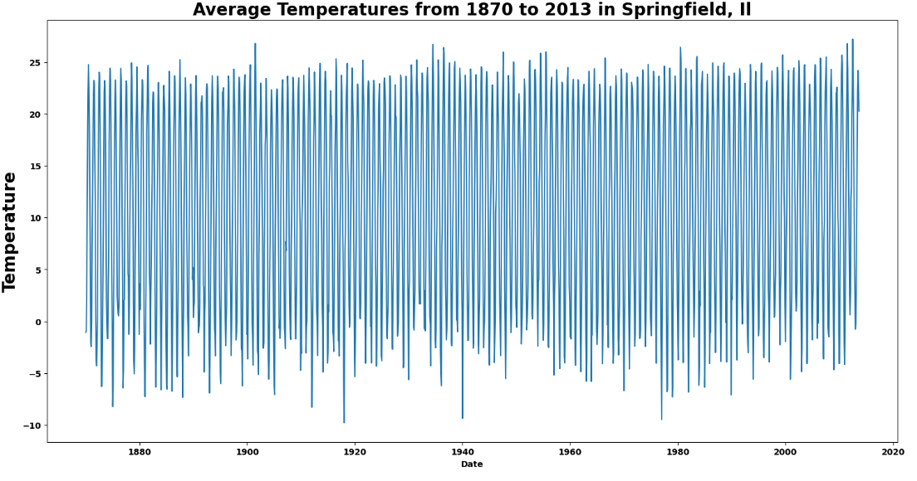
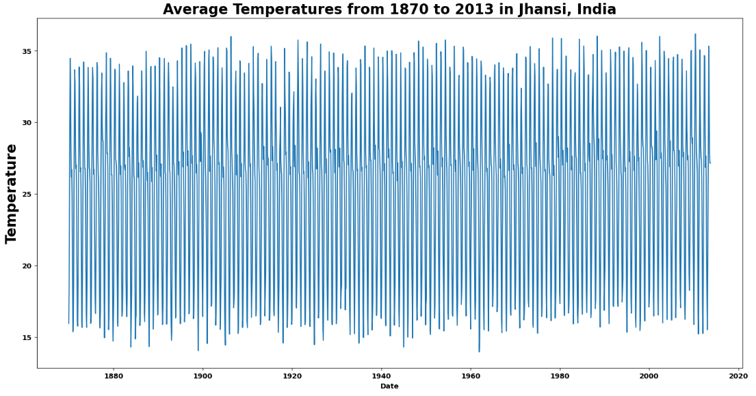
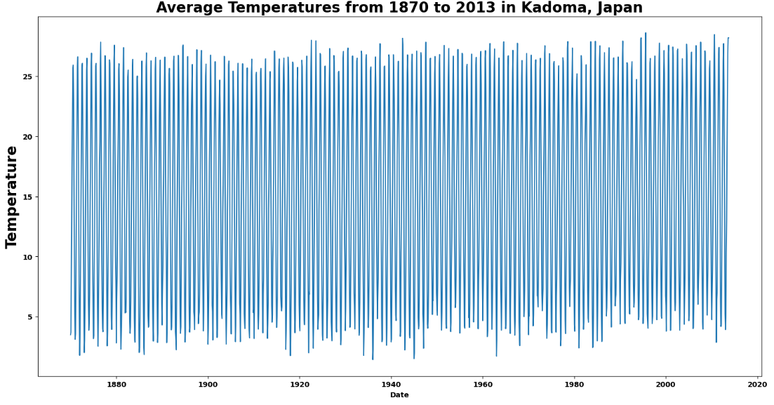
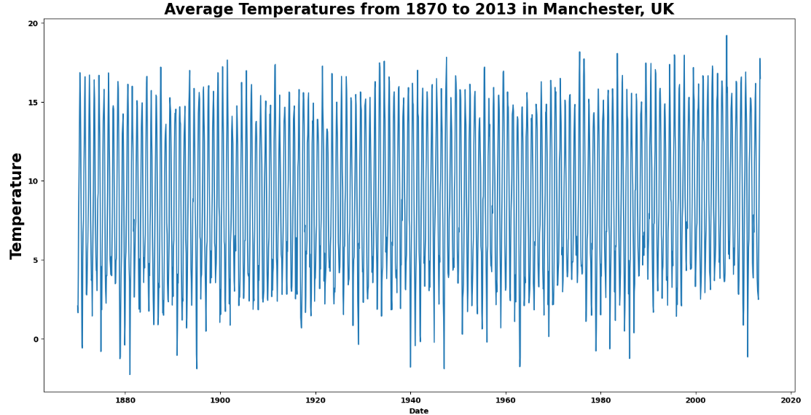
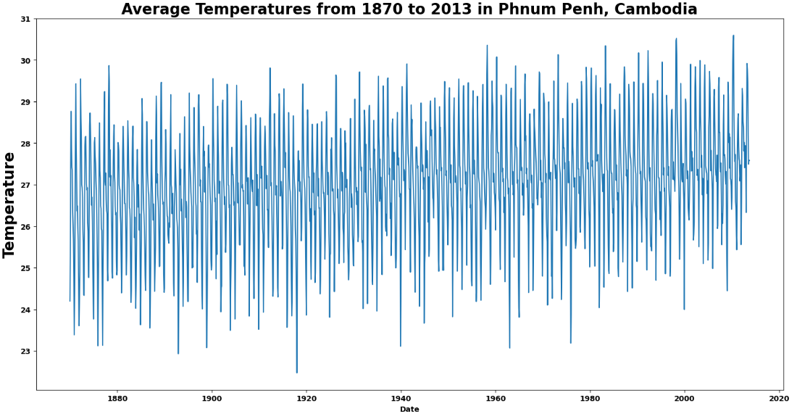
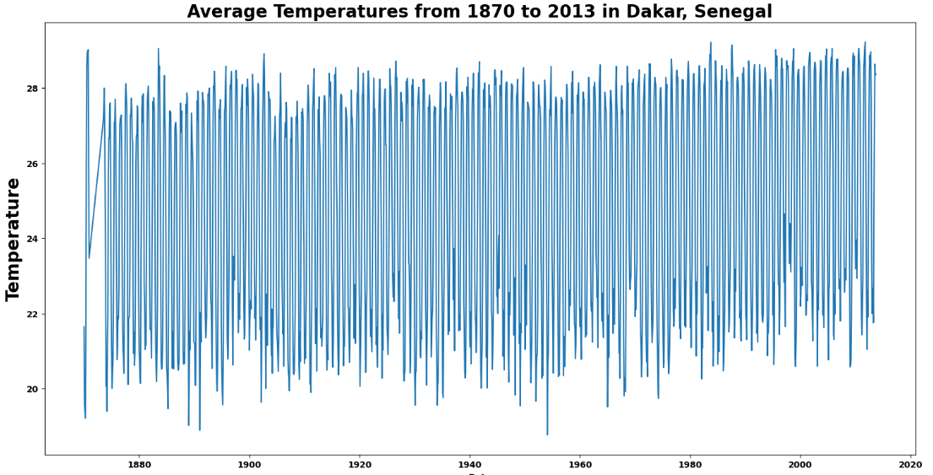
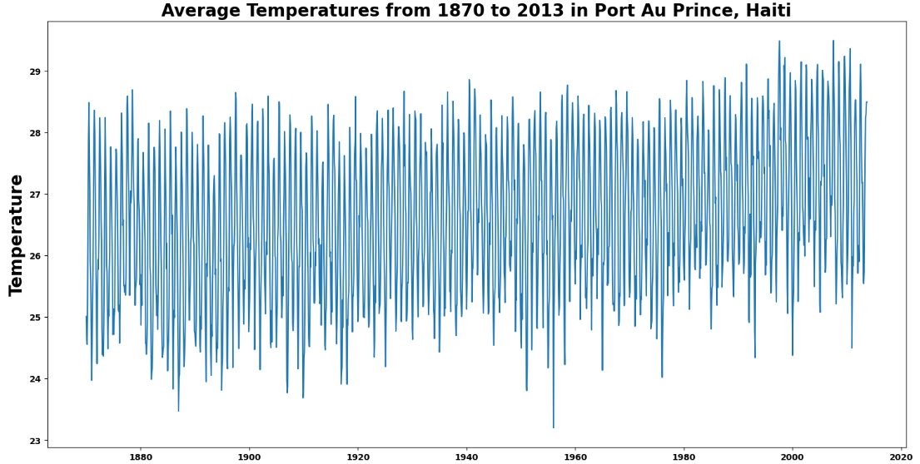
Average Temperatures of the 7 cities
The Datasets have:
Constant variance
Constant mean, but not centered at zero
Let’s take a 1st difference for the datasets

Slide 9
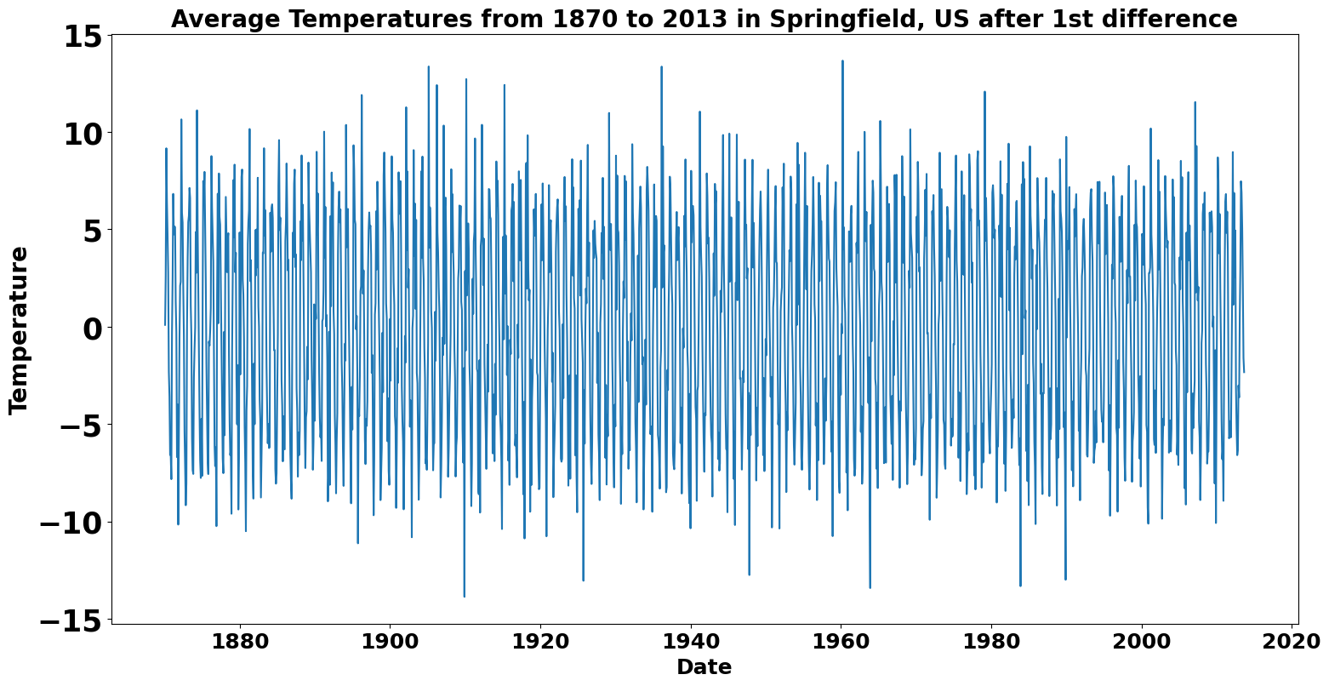
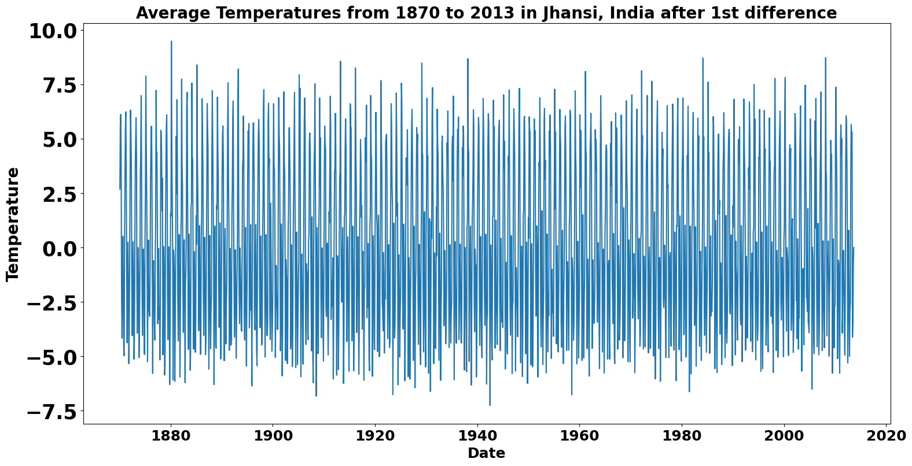
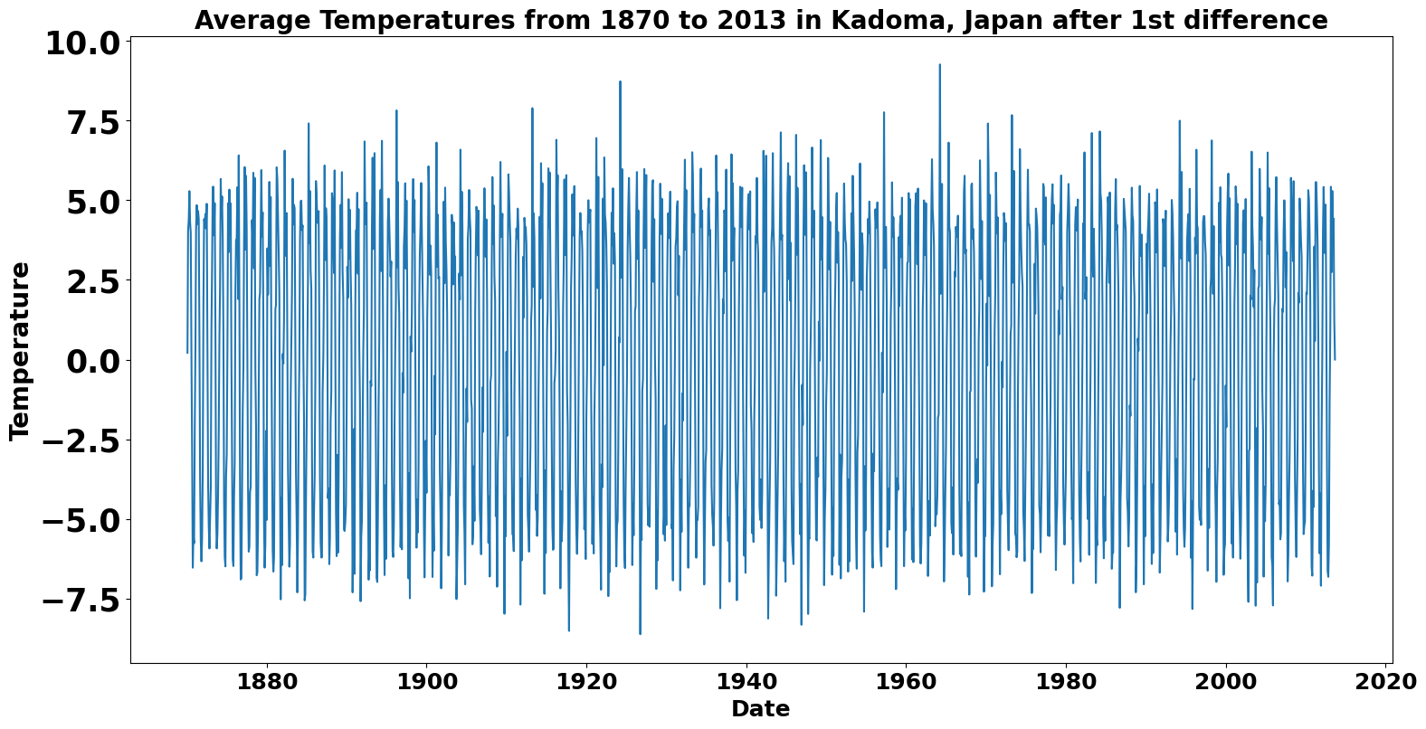
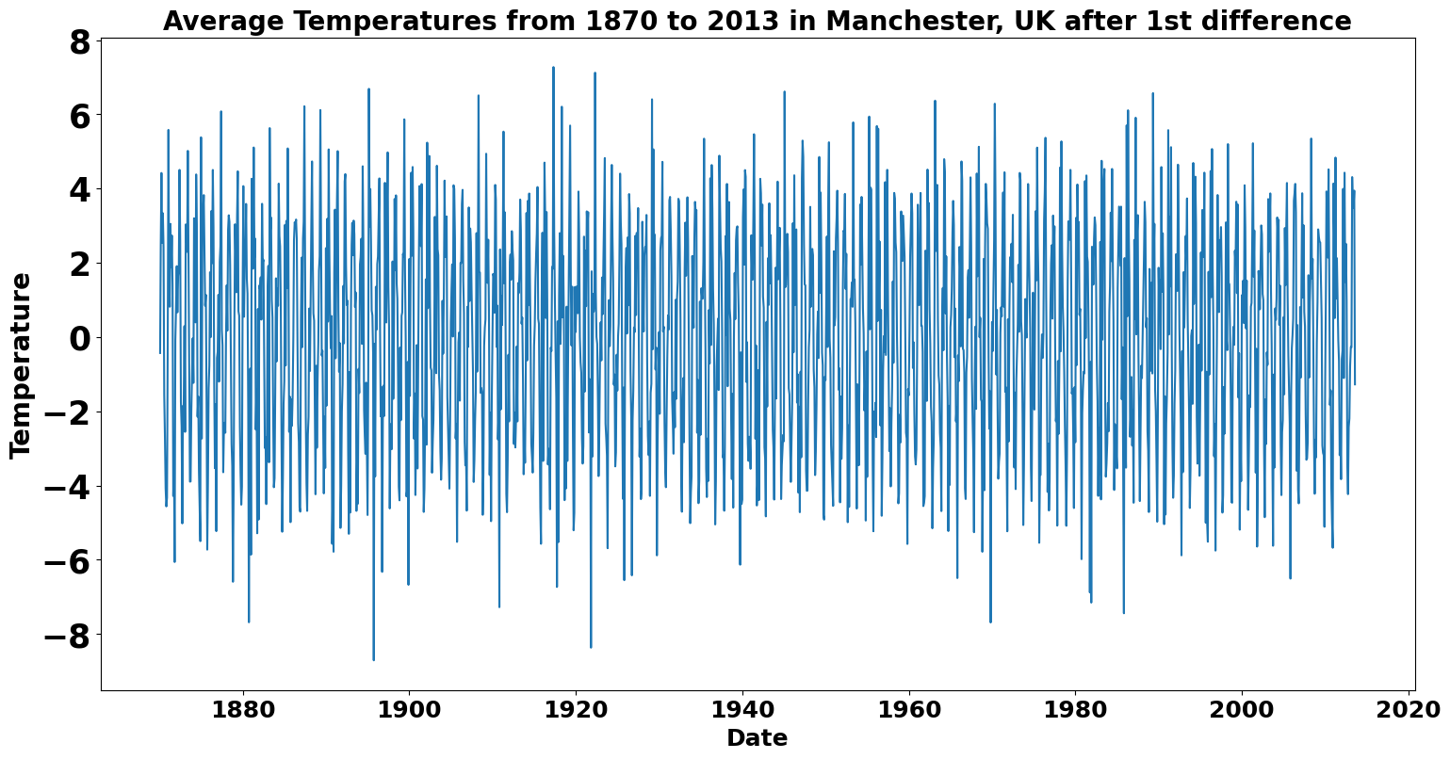
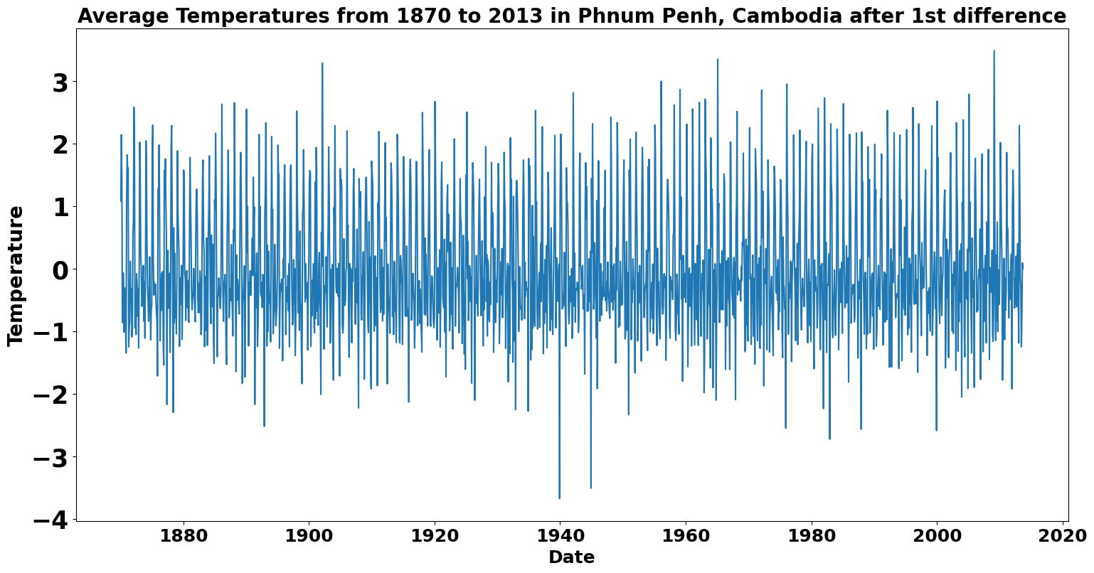
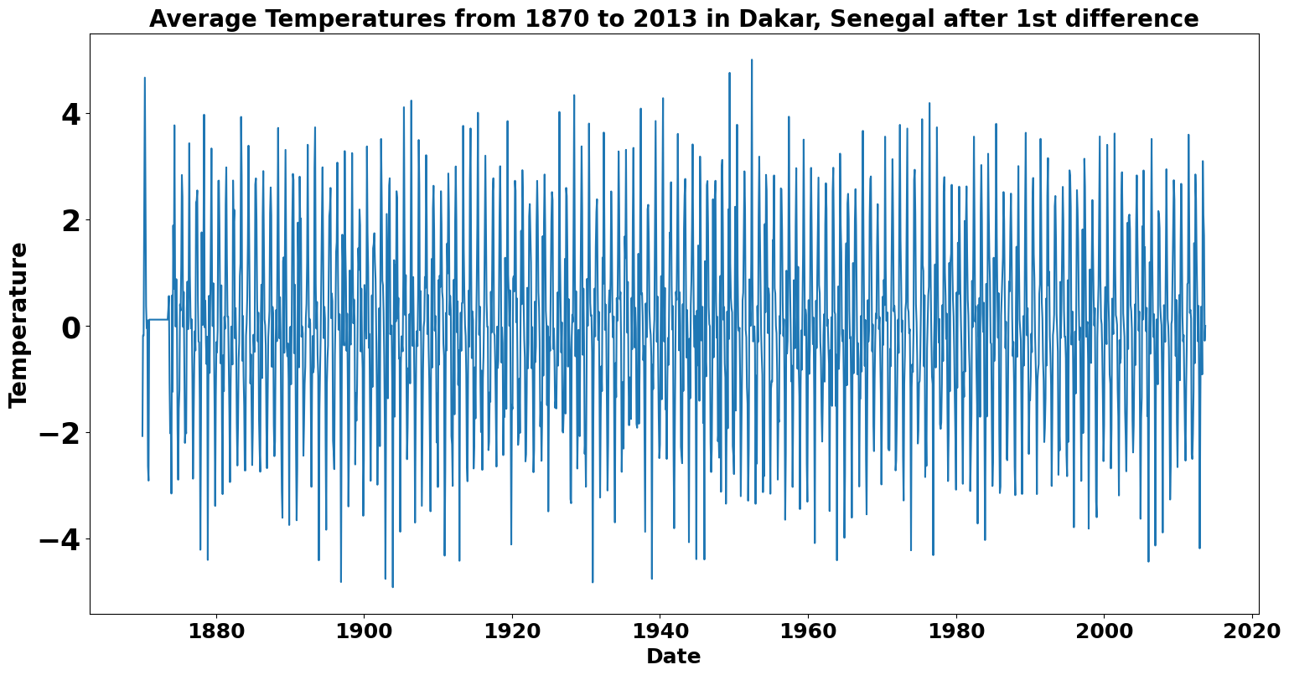
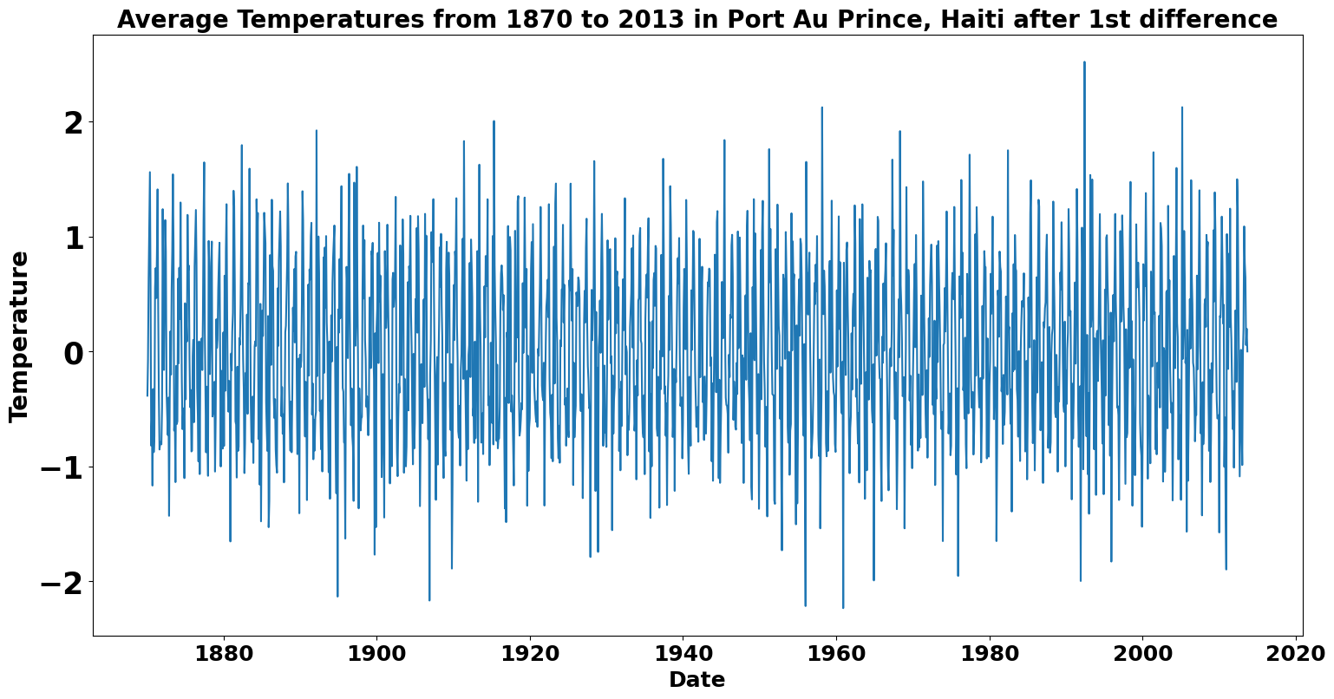
Temperatures after taking a 1st difference
Now that All timeseries are centered at 0 I can:
-split data into training and testing sets
-create forecasts
-project created forecasts onto testing set to determine goodness of fit

Slide 10
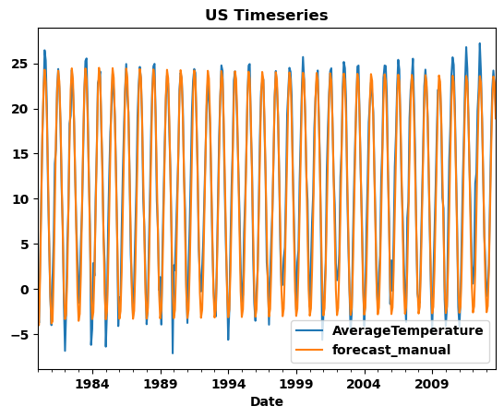
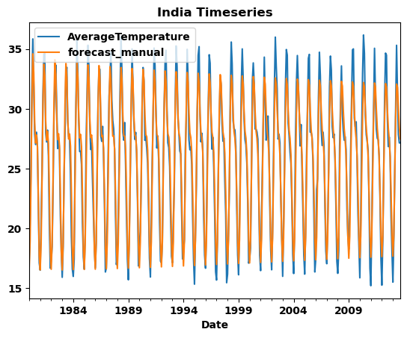
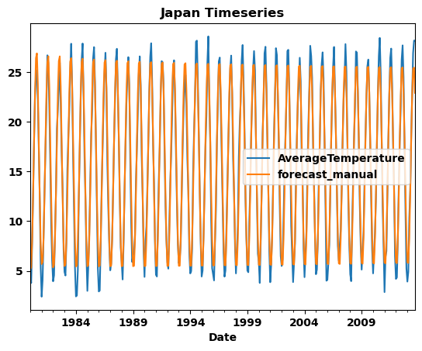
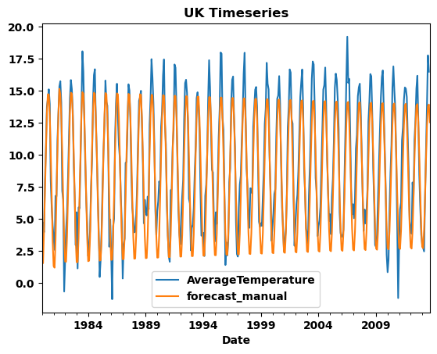
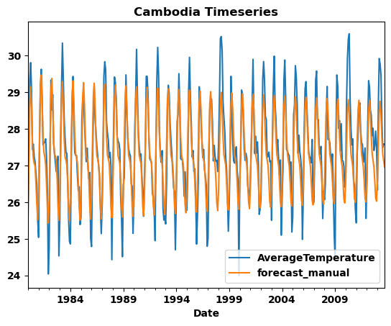
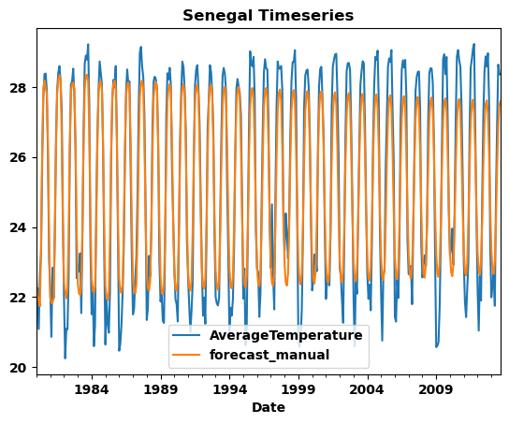
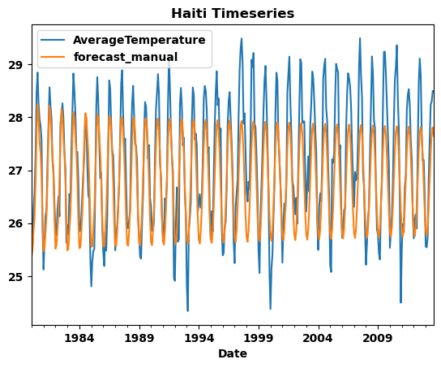
Graphs of forecasts superimposed on actual temperatures
Except for the Haiti timeseries, the
forecasts very closely overlay the actual temperature
Values.
A SARIMA model will be created later for the Haiti timeseries
To see if it fits that data better than the ARIMA model.

Slide 11
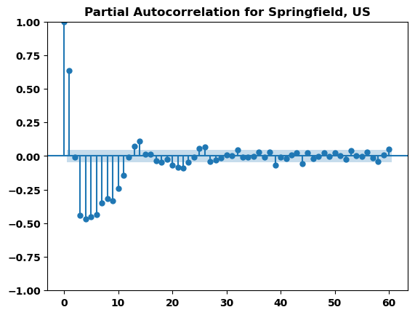
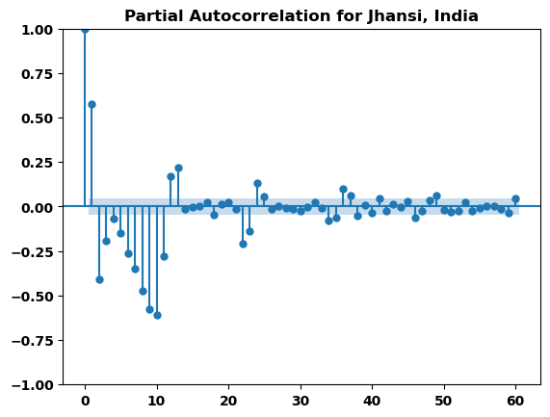
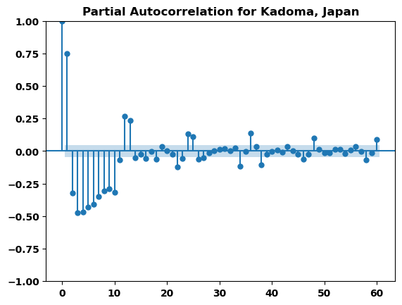
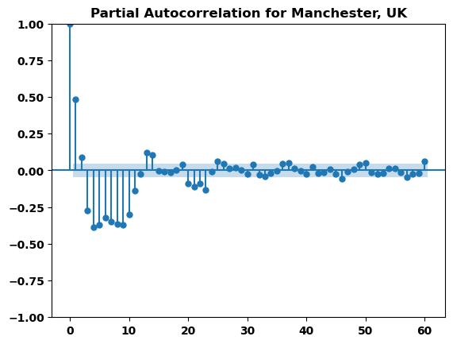
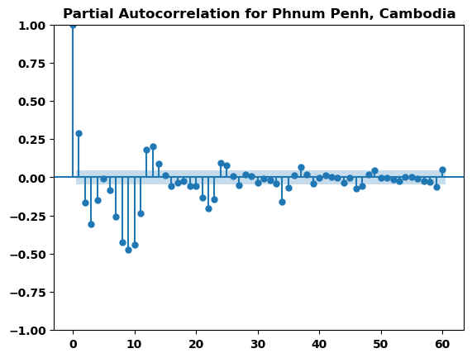
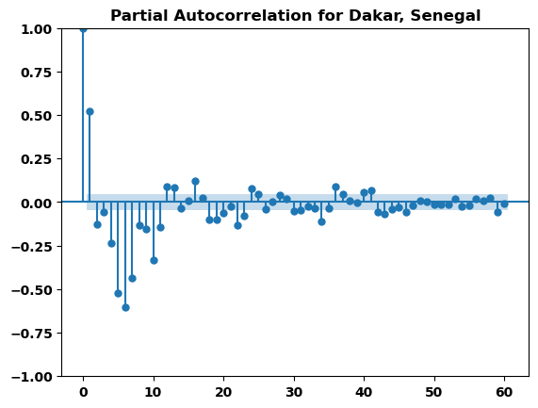
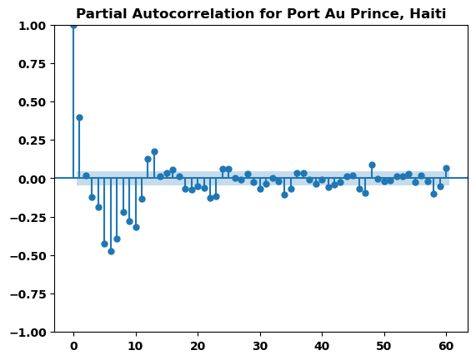
The Arima models have 3 values: p, d, and q.
Each d was determined to be 1 because of the 1st difference taken previously.
Each q will be 0 because these series are simply autoregressive.
The p values will be determined by the following Partial Auto Correlation Functions (PACF):
After experimentation, the following values
Turn out to be the best values for p:
United states: 26
India: 25
Japan: 25
United Kingdom: 24
Cambodia: 37
Senegal: 48
Haiti: 35

Slide 12
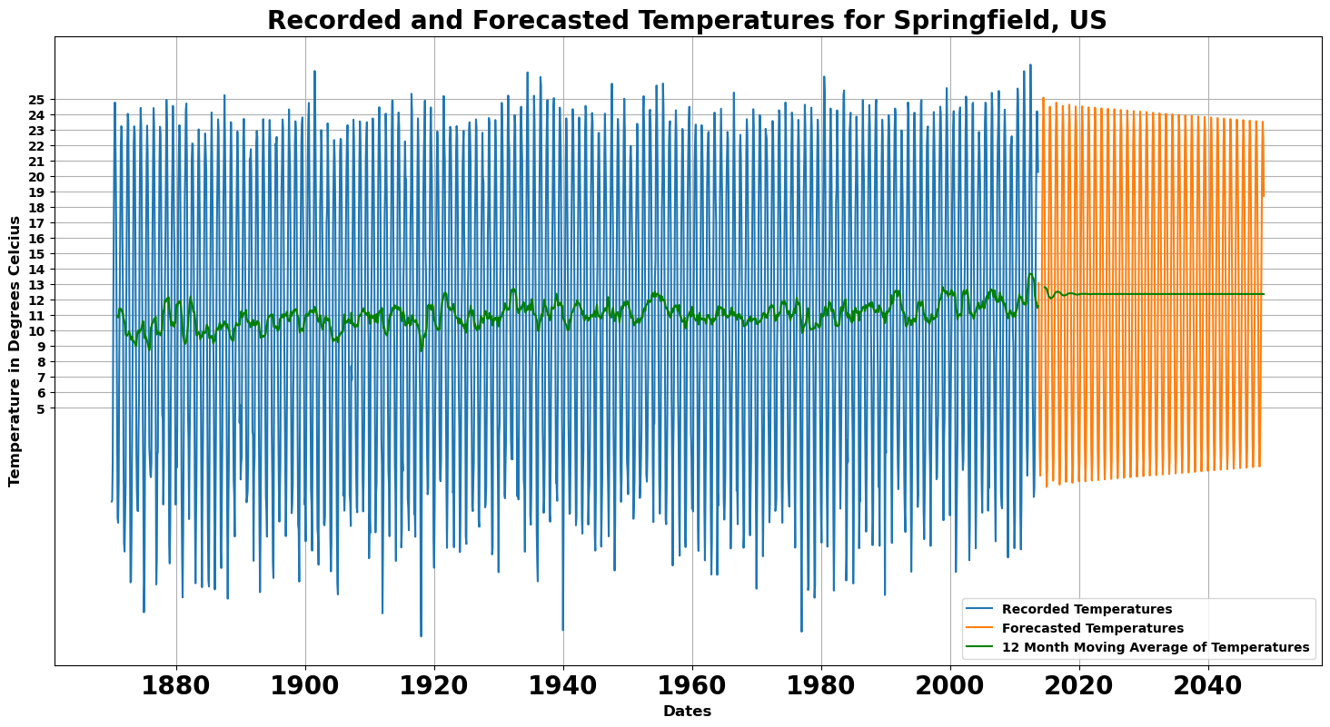
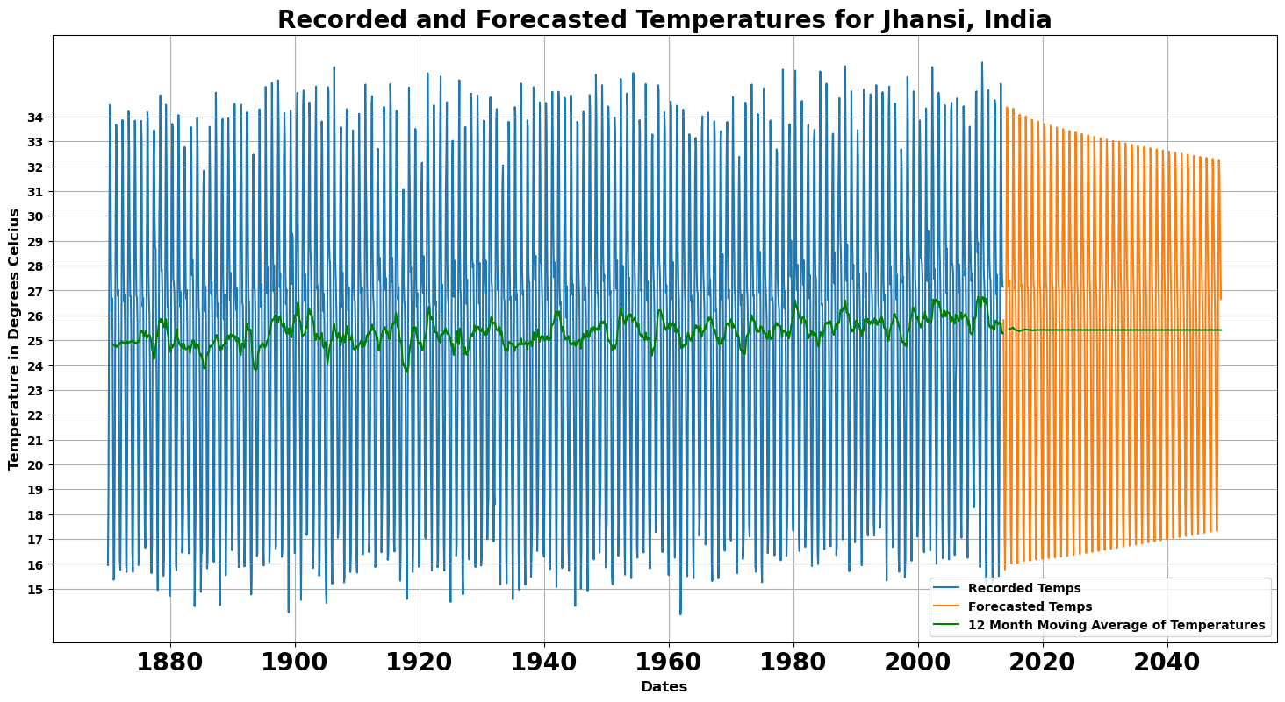
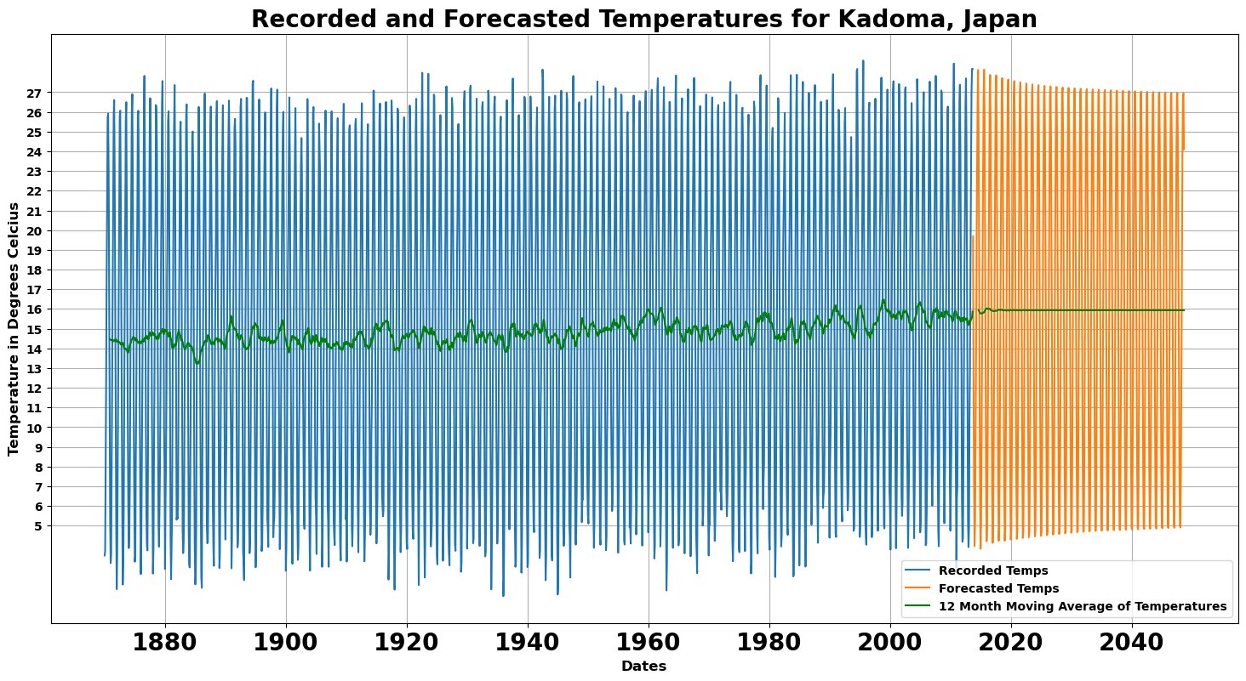
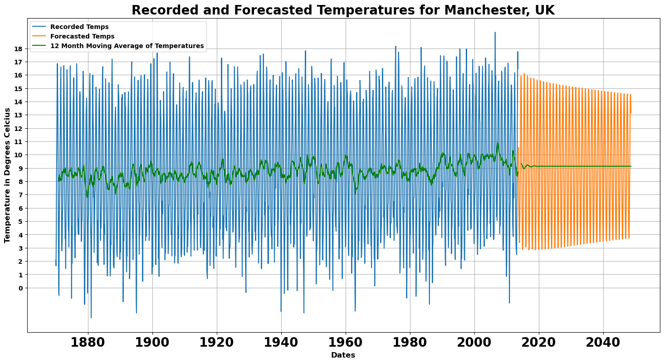
Forecasted Temperatures, Variance of Residual Values, Change in Average Temperature (Green graph)
Variance = 3.2626
Change in Ave. Temp = 3 Deg. Celsius
Variance = 1.1368
Change in Ave. Temp = .5 Deg. Celsius
Variance = 1.0623
Change in Ave. Temp = 1.5 Deg. Celsius
Variance = 1.6970
Change in Ave. Temp = 1.1 Deg. Celsius

Slide 13
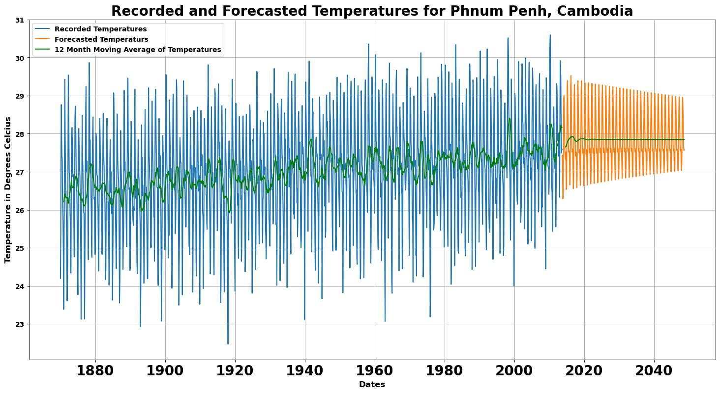
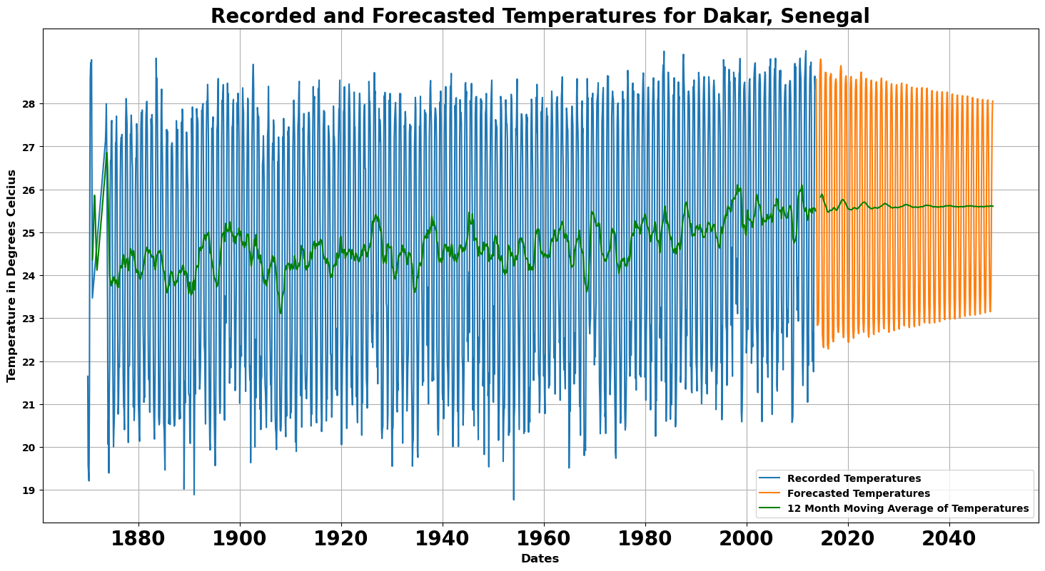
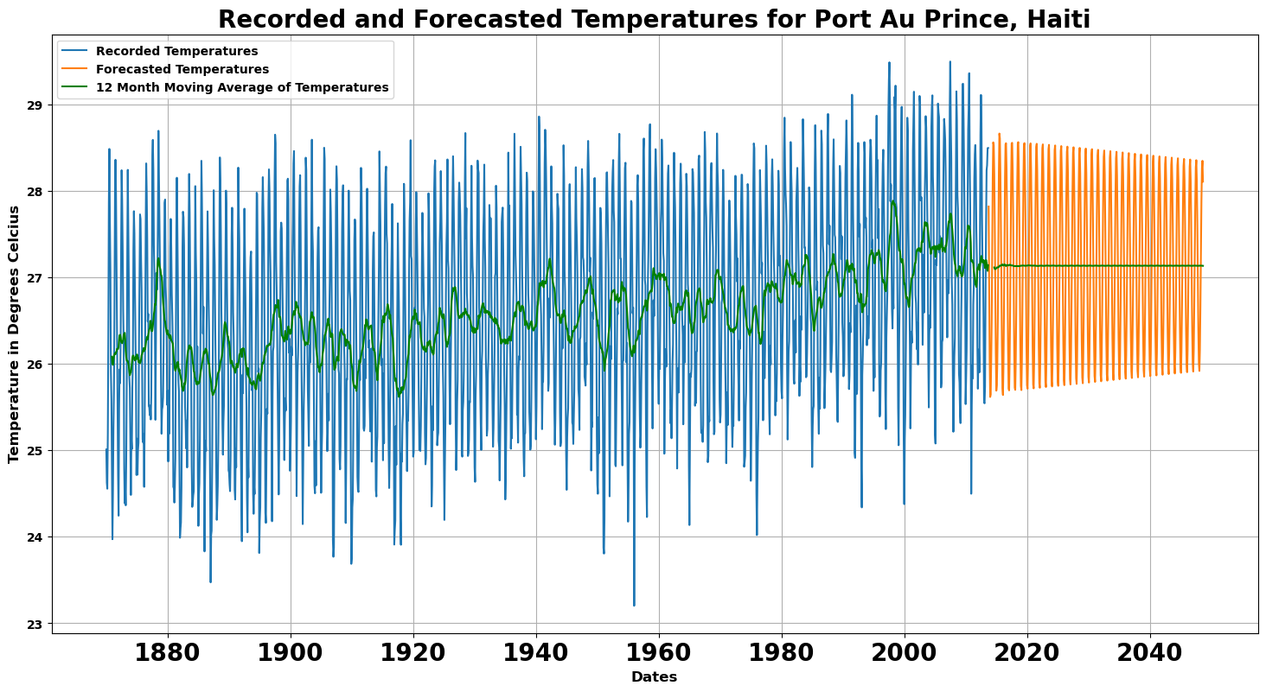
Forecasted Temperatures, Variance of Residual Values, Change in Average Temperature (cont’d)
Variance = .2609
Change in Ave. Temp = 1.4 Deg. Celsius
Variance = .4782
Change in Ave. Temp = 1.6 Deg. Celsius
SUMMARY
The variance readings indicate good
forecasts from the ARIMA model
Change in Ave Temperature typically ranges from
.5 to 1.6 degrees Celsius
The United States appears to be an outlier with temperature
change of 3 degrees Celsius
Variance = .1430
Change in Ave. Temp = 1.1 Deg. Celsius

Slide 14

Is the United States an Anomaly?
Let’s investigate the average temperature change of China from 1870 to 2013 since it is another large, industrialized nation.
We want to determine if China has experienced a change in average temperature as large as the change in the United States.

Slide 15
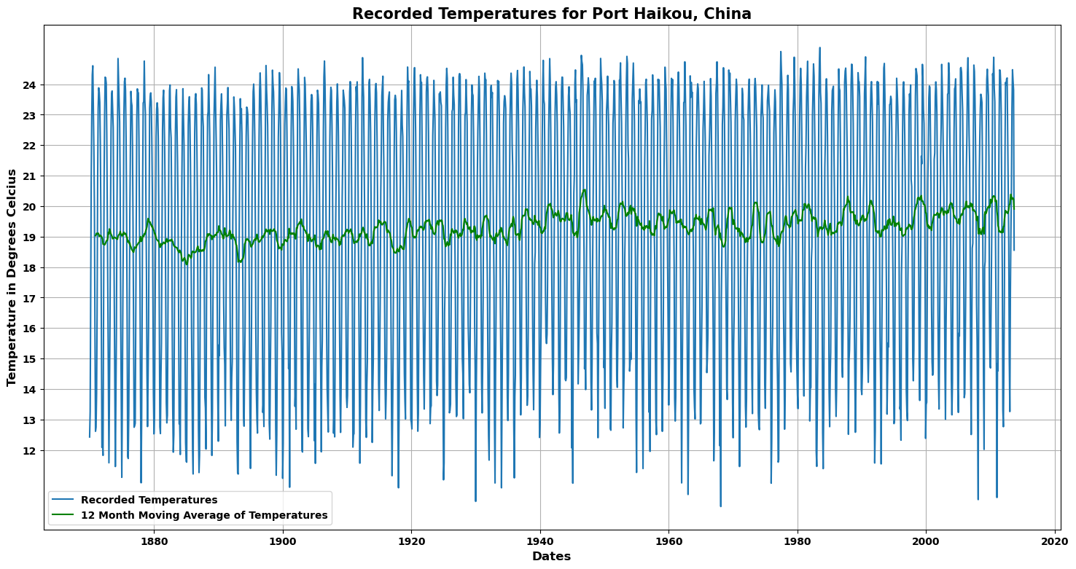
China’s Temperatures from 1870 – 2013 and Average Temperature increase
The average temperature (graphed with green line) increased
by about 1.1 degrees Celsius, which is in line with the previously
analyzed countries.
The United States appears to an anomaly with
an average temperature increase of 3 degrees Celsius

Slide 16

What about the timeseries for Haiti?
When the data for Haiti was modeled using ARIMA, the results were not as good as with the other 6 countries. Now I will use a similar model, SARIMA, which takes seasonality into account. This is motivated from the actual temperatures appearing to have a bit of an incline towards the later years.

Slide 17

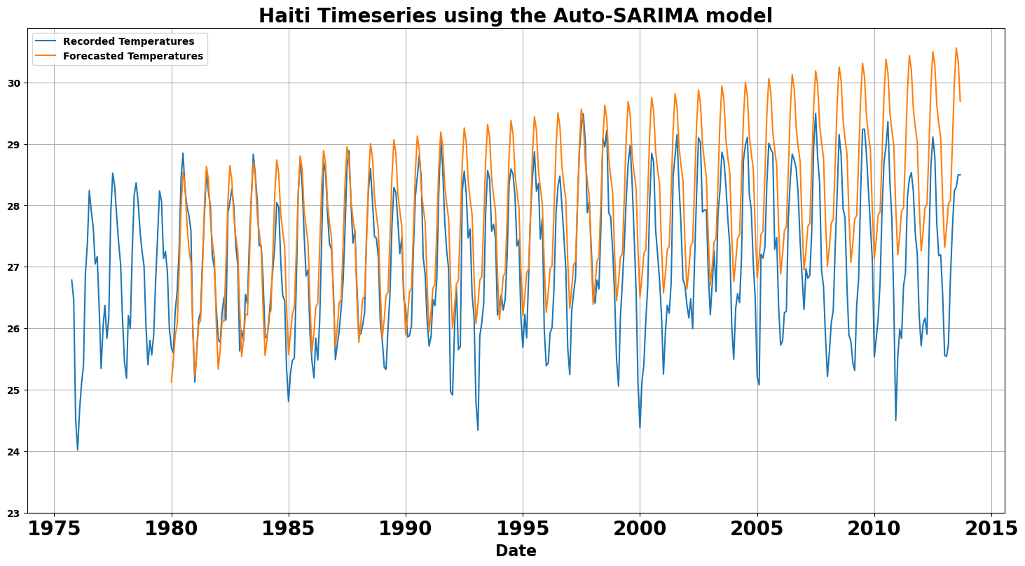
Comparison of SARIMA and ARIMA models
THE ARIMA MODEL
The SARIMA model does a decent forecast for the
first 10 years but then it starts to deteriorate. The ARIMA
model misses the forecast on the top but seems to
be pretty accurate in the middle and bottom over the entire
range of dates.
This Photo by Unknown Author is licensed under CC BY-NC-ND

Slide 18
CONCLUSIONS / RECOMMENDATIONS
Global warming is real
In general, developing countries are just as responsible for global warming as industrialized countries
The United States has contributed to global warming to a larger degree than other countries, as evidenced by its larger increase in average temperatures.
The ARIMA model is a better model for forecasting temperatures than the SARIMA model.

